Slide 1
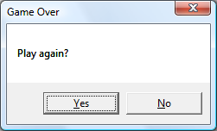
Get_color
IA
The player input
Loop
Rapport sur les spécifications des fonctions
Display_board
If 20 turns without any action
play
Data_creation
Logo_and_rules_display
Split_and_sort_input
attack
Perform_actions
Display_board
Display_board
Score_computing
move

